Slide 1
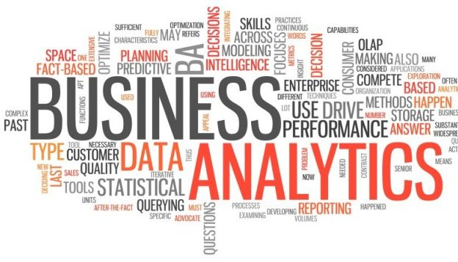
Analytics as a Service

Slide 2
Objective
Subscription based business intelligence and analytics platform providing standard industrial analytics or customer specific analytics.
Supporting any volume of data defined by subscription (Small/Big)

Slide 3
Objective
Dashboard + Bench marking, Self Reporting (Prerequisite for Analytics)
Business
Intelligence
Process Sharing - Domain agnostic
Platform
Multi tenant
Scalable
Stable
>85% Accuracy (Predictive)
Analytics
Prebuilt Analytic module
Customer Specific Analytics
Domain Centric
Subscription (need) based low cost BI and analytics solutions

Slide 4
Service Offerings
Packaged BI
Causal Analytics
Advanced forecasting
Predictive modeling
Business Intelligence
Packaged BI
Advanced Analytics
Advanced forecasting
Causal Analytics
Mobile BI
Predictive modeling
What happened?
Why did it happen?
What will happen?
What should I do?

Slide 5
Technology Selection
Criteria
Benefits
Enterprise hardened Open Source Applications/Software with active community
Highly Scalable with minimal effort
Built on familiar technologies (Java, SQL and etc..)
Adherence to standards
Compatibility with SQL, NoSQL and Hadoop solutions
Ease of deployment and monitoring
Extensible Architecture
Lower Total Cost of Ownership
Stable and Scalable platform
Minimum learning curve
Lower development and maintenance cost
Easy to troubleshoot
Extendable per future scope (Un- structured /Semi structured data, Social media analytics, …)

Slide 6





Conceptual View
Market Place
BI & Analytics Platform
Data Consumption
Visualization
Subscription
Mining
Storage
Applications
Data
Integration
Data
Quality
Analytics
Processing
Services
Search
Filtering
Boilerplate
Enrichment

Slide 7
Platform Design Approach
Metadata based Multi tenancy
Use Metadata based multi tenancy using API to retrieve, deploy, create, update or delete information such as custom object
Rule based ETL
Configurable
Transformations
Validations
Shared ETL flow for process/ domain across all clients
Files dependencies
Reusable Components
Analytical Models
Visualizations
Rule engine based transformations and validations
Template based BI Objects
Domain/process specific pre-built BI objects that can be deployed as is or extendable per customer requirements

Slide 8
Platform Design Approach Contd..
Security
LDAP and Identity server authorization and authentication
SSL/TLS/ HTTPS/SFTP communication
Appropriate Data Encryption
Scalability and Performance
In built clustering capability
Performance optimized processes/ components
Auto scalable
Information Mgmt.
Data Provenance
Master Data Management
Country Based Compliance and regulation (Starting with India)
Ease of Use
Wizard driven subscription
Intuitive UI
Knowledge sharing Community
Reliable, Manageable, and Extendable
Monitoring dashboards and alerts
Mature deployment processes
Extendable components/architecture

Slide 9
Referential Architecture
DATA SOURCES
INTEGRATION
DATA STORAGES
ANALYTICS
PRESENTATION
Structured
ETL
Data
Warehouse
Query/
Reporting
Web
Browser
Semi-
structured
Messaging
Data
Marts
OLAP
Cubes
Native
Desktop
Un-
structured
API/ODBC
Operational
Data Stores
Advanced
Analytics
Mobile
Devices
Replication
Replication
Web
Services

Slide 10
Referential Architecture: Stage 1
DATA SOURCES
INTEGRATION
DATA STORAGES
ANALYTICS
PRESENTATION
Structured
ETL
RDBMS
Query/
Reporting
Web
Browser
Semi-
structured
Messaging
NoSQL
OLAP
Cubes
Native
Desktop
Un-
structured
API/ODBC
Advanced
Analytics
Mobile
Devices
Replication
Replication
Web
Services

Slide 11






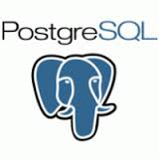




Stage 1 Architecture: Components
DATA SOURCES
INTEGRATION
DATA STORAGES
ANALYTICS
PRESENTATION
Structured
ETL
RDBMS
Query/
Reporting
Web
Browser
Semi-
structured
Messaging
OLAP
Cubes
Native
Desktop
Un-
structured
API/ODBC
Advanced
Analytics
Mobile
Devices
Replication
Replication
Web
Services

Slide 12
Functional Architecture
Business Intelligence
Visual Analytics
Real-time Reporting
Manage Information
PRESENTATION
ANALYTICS
Legacy/
Casual analytics
Statistical methods
Machine Learning
Media analytics
Speech analytics
Social media and text processing
DATA STORAGE & SEARCH
Develop
deploy and maintain solutions
Data ware house, Data marts and ODS
Storage and Load
Distributed file system and DB
Analytics DB
Distributed Compute
In-memory Distributed Compute
Pit stop 1
Data federation
Stream processing
Enterprise search
Pit stop 2
INTEGRATION
ETL
Service orchestration
Distributed flow control
Complex event processing
Event driven business rules
BPM workflow
DATA SOURCES
Data integration, quality and lineage
Ingestion
Distributed file system
RDBMS and Connectors to Software Apps
Streaming
Connectors to unstructured sources

Slide 13
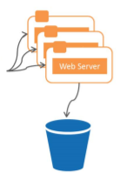
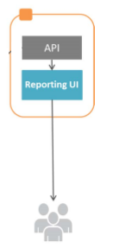


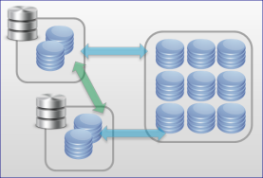

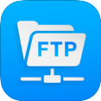

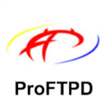














Solution Architecture
Load
Balancer
RDBMS
Business Intelligence
API Management
Content
Delivery
Network
Analytics
Visualization
Technology Components ?
Sol. Powered by ?
Subscription based
business model
Seamless
Authentication &
Authorization
across using
Directory
Services
Massively
Parallel processing
Cluster
Analytics as a
services
Intelligence a click away
Ticket Mgmt. system
For incident tracking
Customer Forum &
Community Support
Market Place driven
Software as a solution

Slide 14
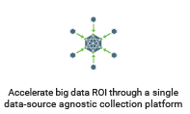
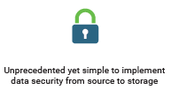
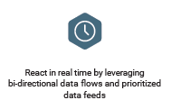

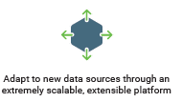
Why Horton Works Dataflow for ETL?
Hortonworks Dataflow
Apache Ambari
Apache Range and Solr
Authorization, Authentication and Auditing
Apache minifi, Storm and Kafka
Easy to deployment and manage the cluster
Monitoring dashboard powered by Ambari views and Grafana
Collection of data at the source of its creation
Real-time data pipelines and streaming
Streams of data and real time analytics
Apache NiFi
Highly configurable
Loss tolerant vs guaranteed delivery
Low latency vs high throughput
Dynamic prioritization
Back pressure
Data Provenance
Track dataflow from beginning to end
Designed for extension
Build your own processors and more
Enables rapid development and effective testing
Secure
SSL, SSH, HTTPS, encrypted content

Slide 15
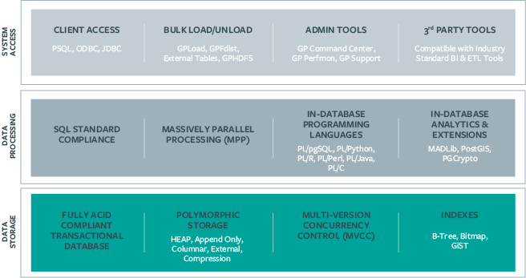
Why Greenplum for Database?
Greenplum
Massively Parallel Processing Shared Nothing Architecture:
Petabyte-Scale Loading: High-performance loading uses MPP Scatter/Gather Streaming technology
Pivotal Query Optimizer: Pivotal Query Optimizer (PQO) is the industry’s first cost-based query optimizer for big data workloads.
In-Database Compression: In-database compression up to 30x disk space reduction
Multi-level Partitioning: Flexible partitioning of tables is based on date, range, or value.
Linear scalability by adding nodes
Self healing fault tolerance
Can run on commodity hardware
Architecture provides automatic parallelization of data and queries
Data Federation using GPHDFS: Greenplum supports data federation with all the major Hadoop distributions for external table
PostGIS support: Spatial database extension that allows GIS (Geographic Information Systems) objects to be stored and processed in the database

Slide 16







Why SpagoBI for Business Intelligence?
 | Reporting Realize structured reports and export them using the most suitable format (HTML, PDF, XLS, XML, TXT, CSV, RTF).
 | Multidimensional analysis (OLAP) Explore your data on different detail levels and from different perspectives, through drill-down, drill-across, slice-and-dice, drill-through processes.
 | Charts Develop ready-to-use interactive charts (e.g. histograms, pie charts, bar charts, area charts, scatter diagrams, line charts, bubble charts, dispersion charts)
 | KPIs Complete set of tools to create, manage, view and browse KPI hierarchy models, through different methods, calculation rules, thresholds and alarm rules.
 | Interactive cockpits Aggregate different analysis into a single view, set navigation paths, and explore your data a dynamic and graphical way.
 | Ad-hoc reporting Self-create your multi-sheet reports, including tables, cross-tables and charts.
 | Location Intelligence Visualize your business data on maps (i.e. static map catalogues or web mapping/feature services) and interact dynamically to get instant views.
SpagoBI
SpagoBI is the only entirely Open Source Business Intelligence suite. It covers all the analytical areas of Business Intelligence projects, with innovative themes and engines.
Multiple Engines for the same functionality e.g. BIRT and Jasper Reports
Data mining Advanced data analysis allowing you to extract knowledge from large volumes of data, to improve your decision-making and business strategies.
Network analysis Visualize and interpret relations among entities through specialized views. An entity can be animate (e.g. social media users) or inanimate (e.g. countries, companies, projects).

Slide 17





Why MADlib for Analytics?
Modelling on entire data
Change the paradigm of analytics from SEMMA to EMMA ( Sample, Explore, Modify, Model and Assess). i.e. Operations done on entire data set instead of samples.
 | Classification Methods to build a model that predicts which of the various categories a new result would fall into.
 | Regression When the desired output is continuous in nature, regression methods are used to build a model that predicts the output value.
 | Clustering Trying to identify groups of data such that the items within one cluster are more similar to each other than they are to the items in any other cluster
 | Association Rule Mining Attempt to identify which items tend to occur together more frequently than random chance would indicate, suggesting an underlying relationship between the items.
 | Descriptive Statistics Helpful in providing information to understand and influence choice of data model.
MADlib
Rich set of modules and growing
Supervised learning
Unsupervised learning
Descriptive Statistics
SQL based hence lean learning curve
Operate on the data locally in-database. Do not move data between multiple runtime environments unnecessarily.
Utilize best of breed database engines, but separate the machine learning logic from database specific implementation details.
Parallel processing
Leverage MPP shared nothing technology, such as the Greenplum and Apache HAWQ to provide parallelism and scalability.

Slide 18
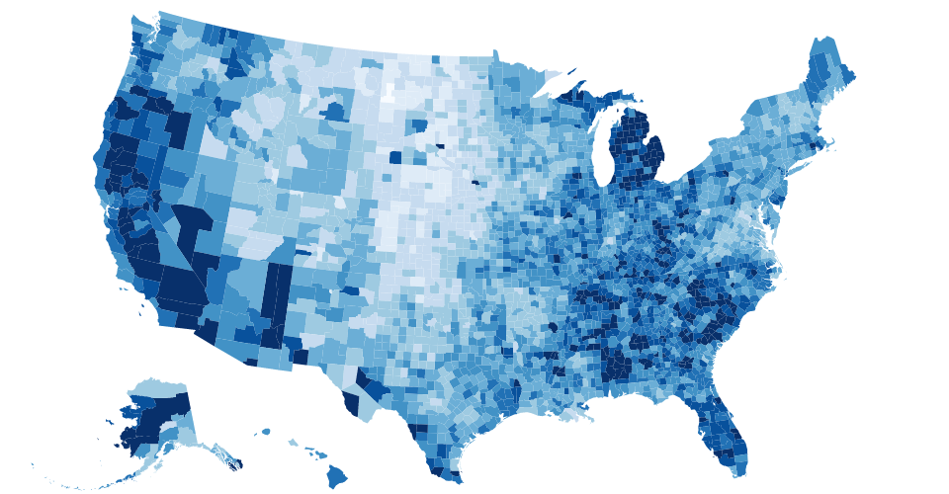
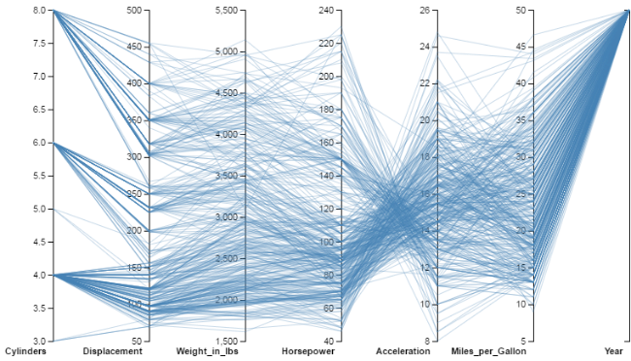
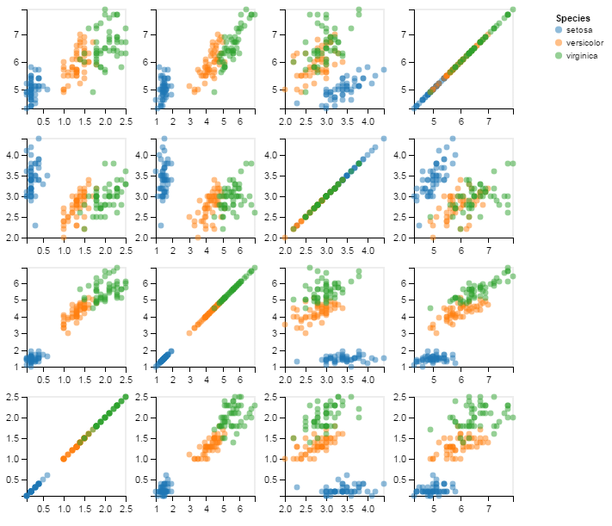
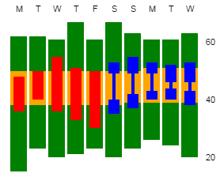
Why Vega for Visualization?
Vega Visualization
Visualization grammar, a declarative format for creating, saving, and sharing interactive designs. (Comparable to ggplot2 (R language) and Tableau's VizQL)
Describe the visual appearance and interactive behavior in a JSON format, and generate views using HTML5 Canvas or SVG. (Specification)
May be read and interpreted by a runtime system to dynamically create visualizations,
Describes the data sets, scale transforms and encoding algorithms, axes and legends, visual marks
Design influenced by the Protovis and D3 frameworks
May be cross-compiled to provide a reusable visualization component.
Streaming Data Operators and APIs to insert, update, and remove data tuples.
Embed interactive views and query widgets into web pages.
Server-side Vega using "headless" rendering.

Slide 19

Pricing Model
Subscription
Packages
One time cost
Client Provisioning
Business Process
Analytic Models
ETL
BI Objects
Dimensions
Data volume
Industry
(Domain)
Business Processes
Usage
Recurring Cost
Monthly/Quarterly Cost based on
Data Volume
Usage
Standard or Custom Solution
Subscription Period
Need based Subscriptions

Slide 20
Roadmap : The capabilities layer
INSIGHT
FORESIGHTS
OPTIMIZE
What best can we do ?
Action
Optimization
Predictive Modeling
What should I do ?
Descriptive Modeling
What will happen ?
Information
What If
Why did it happened ?
OLAP Reporting
What happened ?
Standard Reporting
Basic Data
Raw Data
DECISION SUPPORT
DECISION GUIDANCE

Slide 21
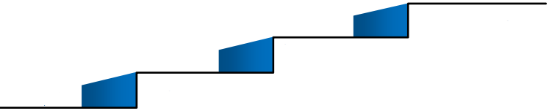
Establishing BI & Analytics Roadmap
Analytical Stage
(Customer Specific)
Capability Stage
(SAAS & Customer Specific)
Business Stage
(Customer Specific)
Technology Stage
(Analytics as a service)
Technology requirements
Carry out technology gap analysis
Create high level solution design
Agree cloud Strategy
Understand business strategies and objectives
Business process & maturity assessments
Identify main priorities & pain points
Shortlist areas of focus and estimated returns
Draw detailed execution roadmap
Build skills & expertise strategy
Data readiness analysis
Translate objectives into analytical requirements
Draw horizontal & vertical capability strategy
What should we do ?
Establish POC (Pit Stop 1, and Pit Stop 2)
Display dashboards with KPI
Establish business priorities
Create support & partnership structure
Estimate investments
& returns – Business
cases
Build POC based BI visualization
Build vertical/horizontal BI models
3. Build customer specific
BI
Build Data Science Operating Models
Vertical/horizontal Capability Selection
Build customer specific analytics model
Mar ‘17
May ‘17
June ‘17
July ‘17

Slide 22
Appendix

Slide 23
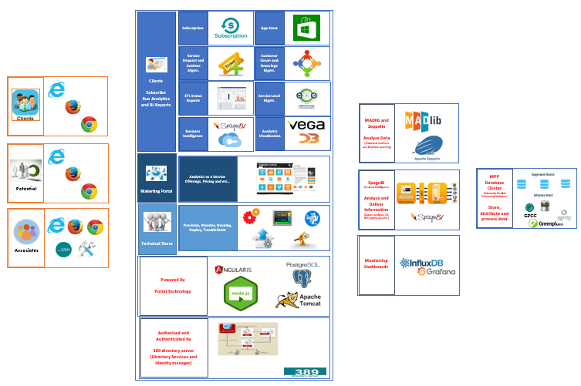
Proposed Architecture

Slide 24
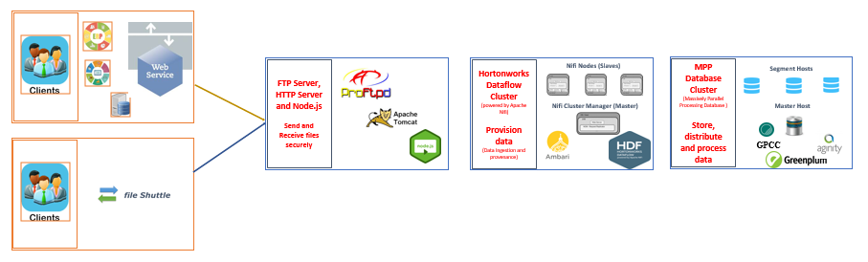
Proposed ETL

Slide 25
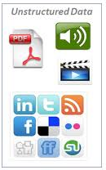
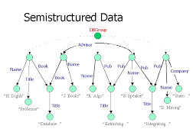
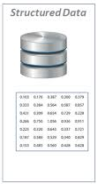
Data Roadmap
Structured Data Source
Semi-structured
Un-structured
Platform evolves

